Slide 1

Introduction
In the next three chapters, we will examine different aspects of capital market theory, including:
Bringing risk and return into the picture of investment management – Markowitz optimization
Modeling risk and return – CAPM, APT, and variations
Estimating risk and return – the Single-Index Model (SIM) and risk and expected return factor models
These provide the framework for both modern finance, which we have briefly discussed already, as well as for quantitative investment management, which will be the subject of the next section of the course

Slide 2

Lecture Presentation Software to accompany
Investment Analysis and
Portfolio Management
Seventh Edition by
Frank K. Reilly & Keith C. Brown
Chapter 7

Slide 3
Chapter 7 - An Introduction to Portfolio Management
Questions to be answered:
What do we mean by risk aversion and what evidence indicates that investors are generally risk averse?
What are the basic assumptions behind the Markowitz portfolio theory?
What is meant by risk and what are some of the alternative measures of risk used in investments?

Slide 4
Chapter 7 - An Introduction to Portfolio Management
How do you compute the expected rate of return for an individual risky asset or a portfolio of assets?
How do you compute the standard deviation of rates of return for an individual risky asset?
What is meant by the covariance between rates of return and how do you compute covariance?

Slide 5
Chapter 7 - An Introduction to Portfolio Management
What is the relationship between covariance and correlation?
What is the formula for the standard deviation for a portfolio of risky assets and how does it differ from the standard deviation of an individual risky asset?
Given the formula for the standard deviation of a portfolio, how and why do you diversify a portfolio?

Slide 6
Chapter 7 - An Introduction to Portfolio Management
What happens to the standard deviation of a portfolio when you change the correlation between the assets in the portfolio?
What is the risk-return efficient frontier?
Is it reasonable for alternative investors to select different portfolios from the portfolios on the efficient frontier?
What determines which portfolio on the efficient frontier is selected by an individual investor?

Slide 7
Background Ideas
As an investor you want to maximize the returns for a given level of risk.
The relationship between the returns for the different assets in the portfolio is important.
A good portfolio is not simply a collection of individually good investments.

Slide 8
Risk Aversion
Given a choice between two assets with equal rates of return, most investors will select the asset with the lower level of risk.
Risk aversion is a consequence of decreasing marginal utility of consumption.

Slide 9
Evidence That
Investors are Risk-Averse
Many investors purchase insurance for: Life, Automobile, Health, and Disability Income. The purchaser trades known costs for unknown risk of loss.
Yields on bonds increase with risk classifications, from AAA to AA to A …
Lottery tickets seemingly contradict risk aversion, but provide potential for purchasers to move into a new class of consumption.

Slide 10
Definition of Risk
But, how do you actually define risk?
Uncertainty of future outcomes
or
Probability of an adverse outcome

Slide 11
Markowitz Portfolio Theory
Old adage is:
  “Don’t put all your eggs in one basket.”
  But, how many baskets should you use?
  And how what proportion of your eggs should you put in each basket?
Harry Markowitz
  wrestled with these questions
  figured out a way to answer both of them
  Earned a Nobel Prize in Economics (1990) for his efforts

Slide 12
Markowitz Portfolio Theory
Quantifies risk
Derives the expected rate of return for a portfolio of assets and an expected risk measure
Shows that the variance of the rate of return is a meaningful measure of portfolio risk
Derives the formula for computing the variance of a portfolio, showing how to effectively diversify a portfolio
Provides both:
  the foundation for Modern Finance
  a key tool for Haugen’s New Finance

Slide 13
Assumptions of
Markowitz Portfolio Theory
1. Investors consider each investment alternative as being presented by a probability distribution of expected returns over some holding period.

Slide 14
Assumptions of
Markowitz Portfolio Theory
2. Investors minimize one-period expected utility, and their utility curves demonstrate diminishing marginal utility of wealth.
  I.e., investors like higher returns, but they are risk-averse in seeking those returns
  And, again, this is a one-period model (i.e., the portfolio will need to be rebalanced at some point in the future in order to remain optimal)

Slide 15
Assumptions of
Markowitz Portfolio Theory
3. Investors estimate the risk of the portfolio on the basis of the variability of expected returns.
  I.e., out of all the possible measures, variance is the key measure of risk

Slide 16
Assumptions of
Markowitz Portfolio Theory
4. Investors base decisions solely on expected return and risk, so their utility curves are a function of only expected portfolio returns and the expected variance (or standard deviation) of portfolio returns.
  Investors’ utility curves are functions of only expected return and the variance (or standard deviation) of returns.
  Stocks’ returns are normally distributed or follow some other distribution that is fully described by mean and variance.

Slide 17
Assumptions of
Markowitz Portfolio Theory
5. For a given risk level, investors prefer higher returns to lower returns. Similarly, for a given level of expected returns, investors prefer less risk to more risk.

Slide 18
Markowitz Portfolio Theory
Using these five assumptions, a single asset or portfolio of assets is considered to be efficient if no other asset or portfolio of assets offers higher expected return with the same (or lower) risk, or lower risk with the same (or higher) expected return.

Slide 19
Expected Rates of Return
For an individual asset:
  sum of the potential returns multiplied with the corresponding probability of the returns
For a portfolio of assets:
  weighted average of the expected rates of return for the individual investments in the portfolio

Slide 20
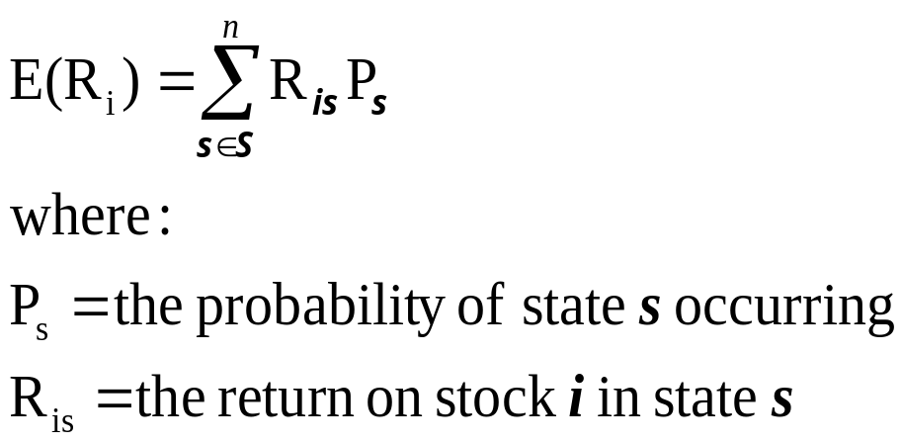
Computation of Expected Return for an Individual Risky Investment
Exhibit 7.1

Slide 21
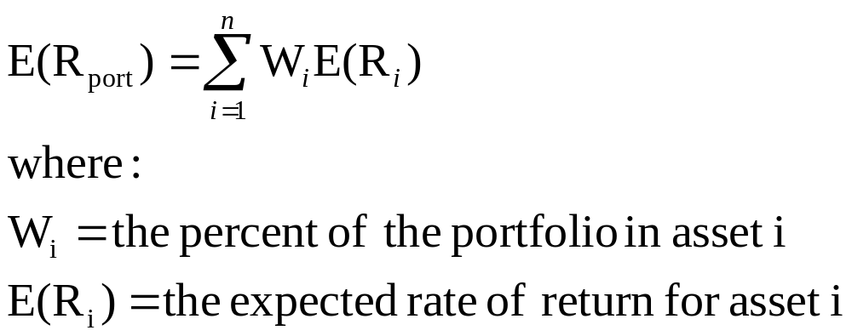
Computation of the Expected Return for a Portfolio of Risky Assets
Exhibit 7.2

Slide 22
Variance (Standard Deviation) of Returns for an Individual Investment
Variance is a measure of the variation of possible rates of return R_{i}, away from the expected rate of return [E(R_{i})].
Standard deviation is the square root of the variance.

Slide 23
Variance and Standard Deviation of Returns for an Individual Investment
Formulas:

Slide 24

Variance (Standard Deviation) of Returns for an Individual Investment
Exhibit 7.3
Variance ( ²) = .0050
Standard Deviation ( ) = .02236

Slide 25
Standard Deviation of Returns for a Portfolio
Formula:
Two-Stock:
More than two stocks:

Slide 26
Portfolio Standard Deviation Calculation
Any asset of a portfolio may be described by two characteristics:
  The expected rate of return
  The expected standard deviations of returns
A third characteristic, the covariance between a pair of stocks, also drives the portfolio standard deviation
  Unlike portfolio expected return, portfolio standard deviation is not simply a weighted average of the standard deviations for the individual stocks
  For a well-diversified portfolio, the main source of portfolio risk is covariance risk; the lower the covariance risk, the lower the total portfolio risk

Slide 27
Covariance of Returns
Covariance is a measure of:
  the degree of “co-movement” between two stocks’ returns, or
  the extent to which the two variables “move together” relative to their individual mean values over time

Slide 28
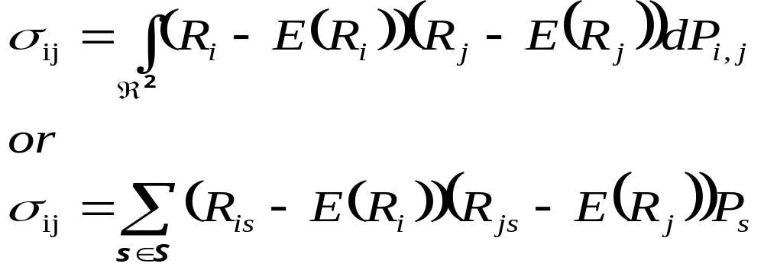
Covariance of Returns
For two assets, i and j, the covariance of rates of return is defined as:

Slide 29
Covariance and Correlation
The correlation coefficient is obtained by standardizing (dividing) the covariance by the product of the individual standard deviations

Slide 30
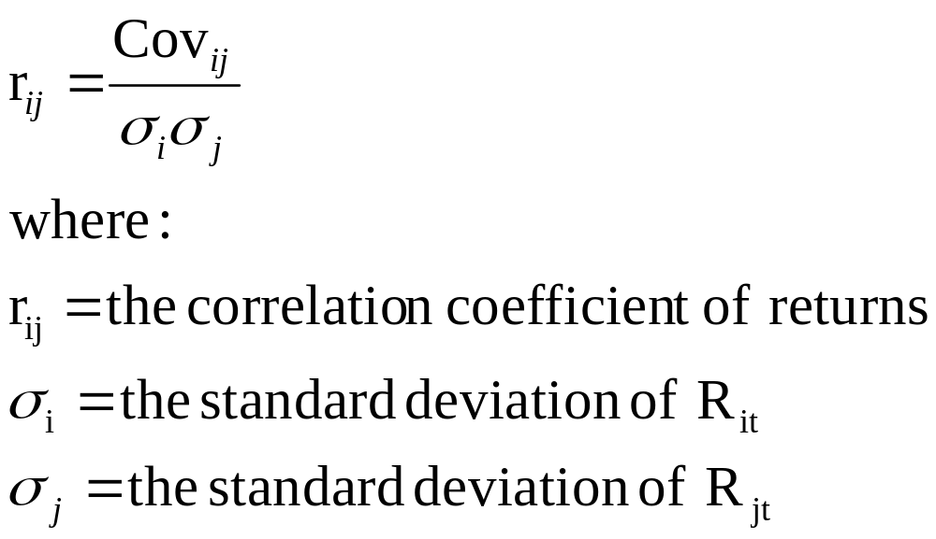
Covariance and Correlation
Correlation coefficient varies from -1 to +1

Slide 31
Correlation Coefficient
It can vary only in the range +1 to -1. A value of +1 would indicate perfect positive correlation. This means that returns for the two assets move together in a completely linear manner. A value of –1 would indicate perfect correlation. This means that the returns for two assets have the same percentage movement, but in opposite directions

Slide 32
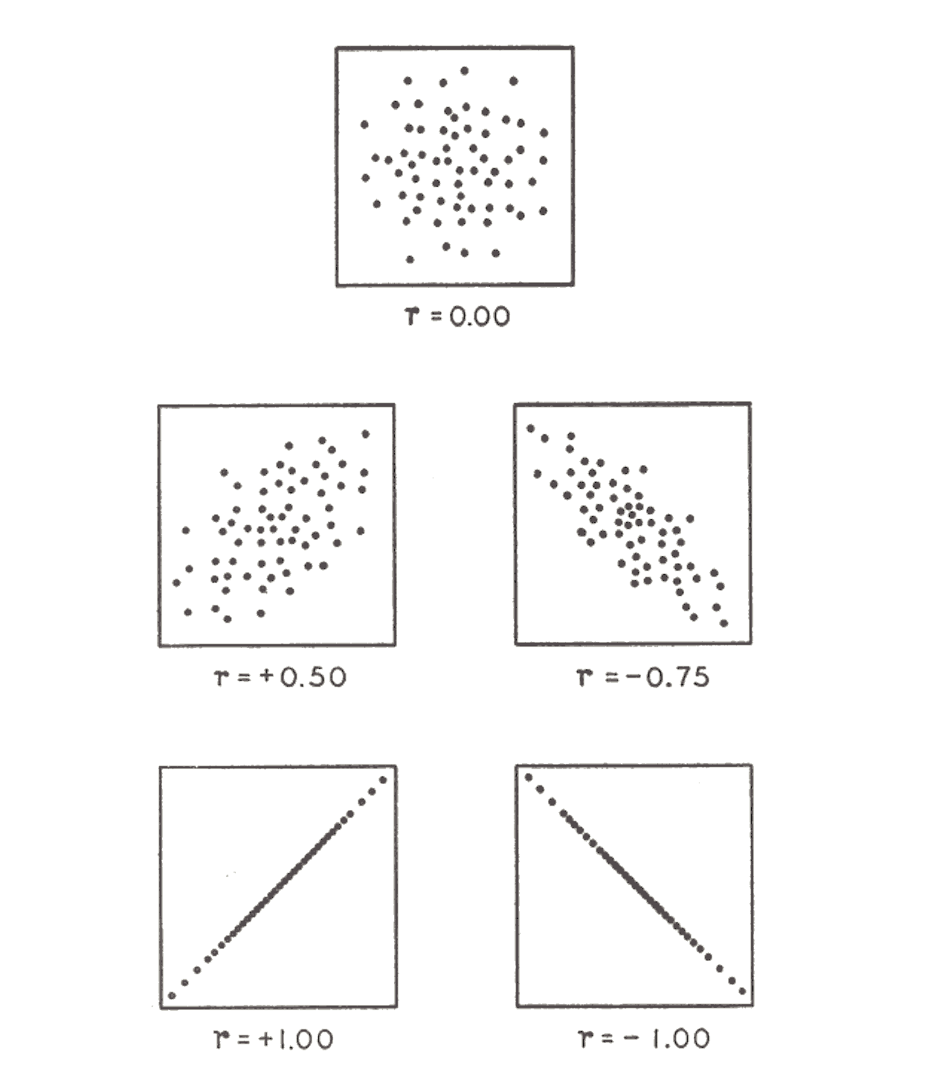

Correlation Coefficient

Slide 33
Parameters vs. Estimates
Unfortunately, no one knows the true values for the expected return and variance and covariance of returns
These must be estimated from the available data
The most basic way to estimate these is the naïve or unconditional estimate
  uses the sample mean, sample variance, and sample covariance from a time series sample of stock returns
  Typical time series used is last 60 months’ (5 years’) worth of monthly returns
  More sophisticated methods for estimating these will be discussed in subsequent chapters

Slide 34
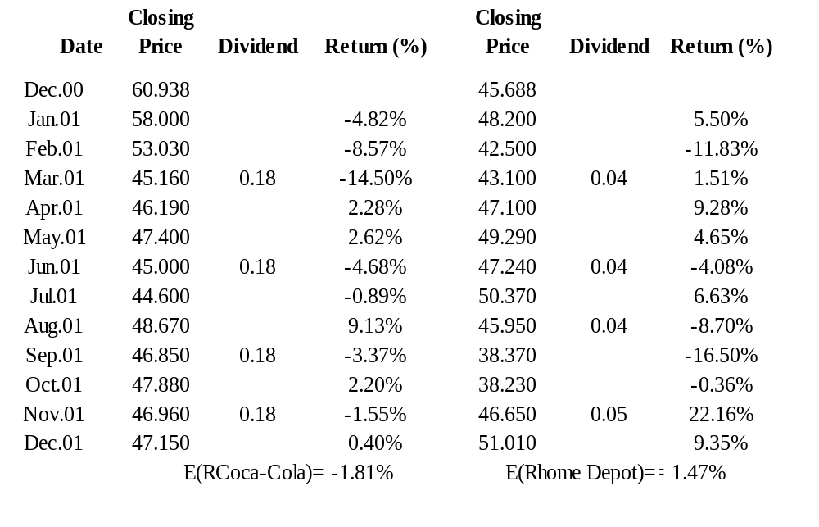
Estimation of Average Monthly Returns for Coca-Cola and Home Depot: 2001
Exhibit 7.4
Computation of Monthly Rates of Return

Slide 35
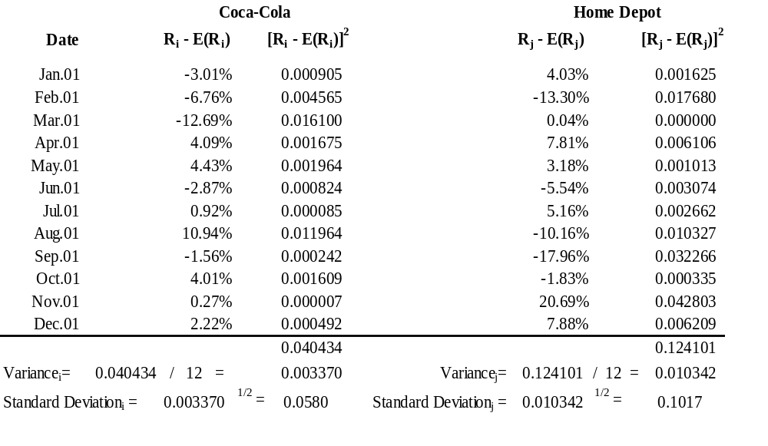
Estimation of Standard Deviation of Returns for Coca-Cola and Home Depot: 2001

Slide 36
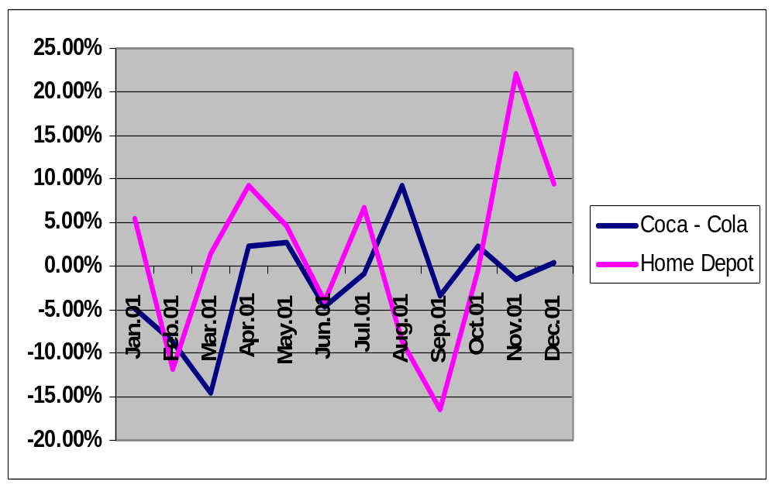
Times Series Returns for
Coca-Cola and Home Depot: 2001

Slide 37
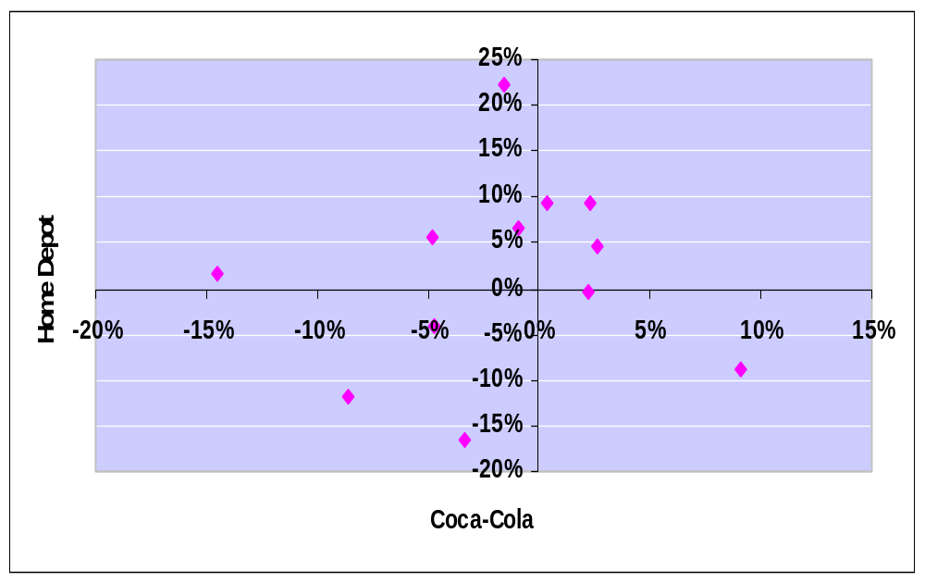
Scatter Plot of Monthly Returns for Coca-Cola and Home Depot: 2001

Slide 38
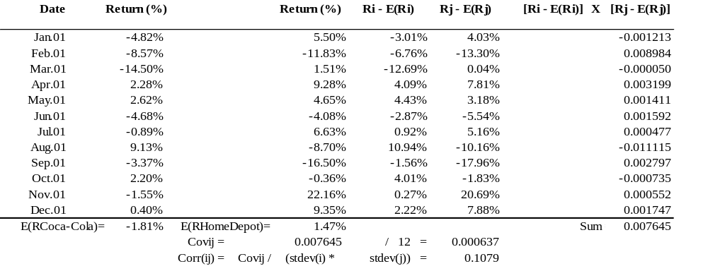
Estimation of Covariance of Returns for Coca-Cola and Home Depot: 2001

Slide 39
Combining Stocks with Different Returns and Risk
Assets may differ in expected rates of return and individual standard deviations
Negative correlation reduces portfolio risk
Combining two assets with -1.0 correlation reduces the portfolio standard deviation to zero only when individual standard deviations are equal

Slide 40
Combining Stocks with Different Returns and Risk
1 .10 .50 .0049 .07
2 .20 .50 .0100 .10
Case Correlation Coefficient Covariance
a +1.00 .0070
b +0.50 .0035
c 0.00 .0000
d -0.50 -.0035
e -1.00 -.0070

Slide 41
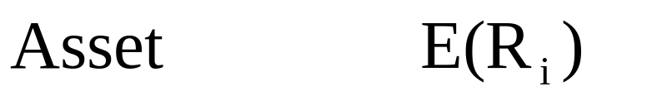
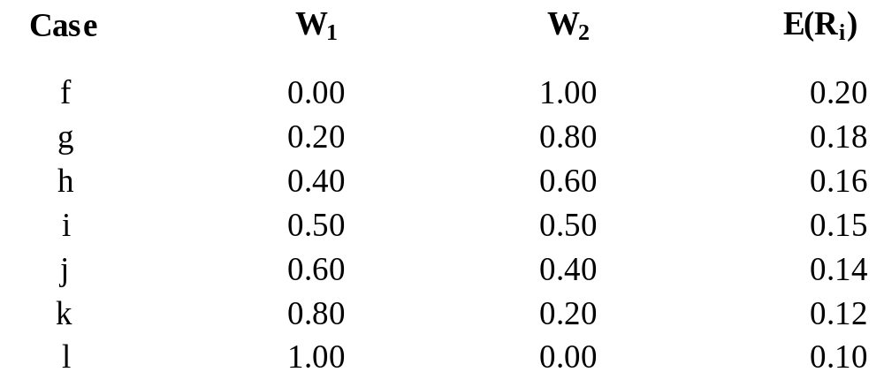
Constant Correlation with Changing Weights
1 .10 r_{ij} = 0.00
2 .20

Slide 42
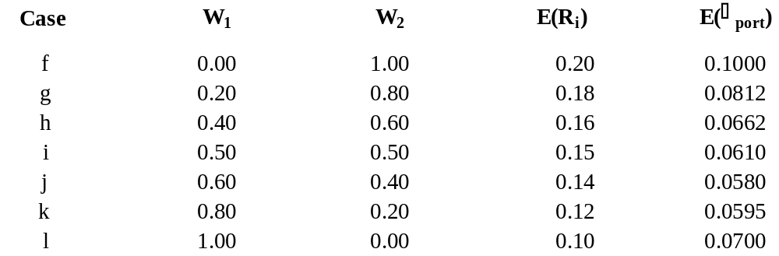
Constant Correlation with Changing Weights

Slide 43
Portfolio Risk-Return Plots for Different Weights
E(R)
2
With two perfectly correlated assets, it is only possible to create a two asset portfolio with risk-return along a line between either single asset
R_{ij} = +1.00
1
Standard Deviation of Return

Slide 44

Portfolio Risk-Return Plots for Different Weights
E(R)
f
g
2
With uncorrelated assets it is possible to create a two asset portfolio with lower risk than either single asset
h
i
j
R_{ij} = +1.00
k
1
R_{ij} = 0.00
Standard Deviation of Return

Slide 45
Portfolio Risk-Return Plots for Different Weights
E(R)
f
g
2
With correlated assets it is possible to create a two asset portfolio between the first two curves
h
i
j
R_{ij} = +1.00
k
R_{ij} = +0.50
1
R_{ij} = 0.00
Standard Deviation of Return

Slide 46
Portfolio Risk-Return Plots for Different Weights
E(R)
With negatively correlated assets it is possible to create a two asset portfolio with much lower risk than either single asset
R_{ij} = -0.50
f
g
2
h
i
j
R_{ij} = +1.00
k
R_{ij} = +0.50
1
R_{ij} = 0.00
Standard Deviation of Return

Slide 47
Portfolio Risk-Return Plots for Different Weights
Exhibit 7.13
E(R)
R_{ij} = -0.50
f
R_{ij} = -1.00
g
2
h
i
j
R_{ij} = +1.00
k
R_{ij} = +0.50
1
R_{ij} = 0.00
With perfectly negatively correlated assets it is possible to create a two asset portfolio with almost no risk
Standard Deviation of Return

Slide 48
The Efficient Frontier
The efficient frontier represents that set of portfolios with the maximum rate of return for every given level of risk, or the minimum risk for every level of return
Frontier will be portfolios of investments rather than individual securities
  Exceptions being the asset with the highest return and the asset with the lowest risk

Slide 49

Efficient Frontier for Alternative Portfolios
Exhibit 7.15
Efficient Frontier
E(R)
B
A
C
Standard Deviation of Return

Slide 50
The Efficient Frontier and Investor Utility
An individual investor’s utility curve specifies the trade-offs he is willing to make between expected return and risk
The slope of the efficient frontier curve decreases steadily as you move upward
These two interactions will determine the particular portfolio selected by an individual investor

Slide 51
The Efficient Frontier and Investor Utility
The optimal portfolio has the highest utility for a given investor
It lies at the point of tangency between the efficient frontier and the utility curve with the highest possible utility

Slide 52
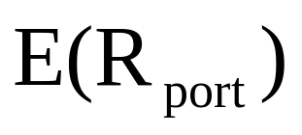
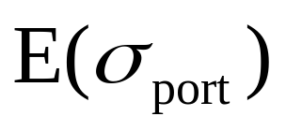
Selecting an Optimal Risky Portfolio
Exhibit 7.16
U_{3’}
U_{2’}
U_{1’}
Y
U₃
X
U₂
U₁

Slide 53
Estimation Issues
Results of portfolio allocation depend on accurate statistical inputs
Estimates of
  Expected returns ( n estimates)
  Standard deviation ( n estimates)
  Correlation coefficient ( [n(n-1)/2] estimates)
    Among entire set of assets
    With 100 assets, 4,950 correlation estimates
    With 500 assets, 124,750 correlation estimates
Estimation risk refers to potential errors
    Typically only have between 60n and 260n observation data points from which to obtain estimates

Slide 54
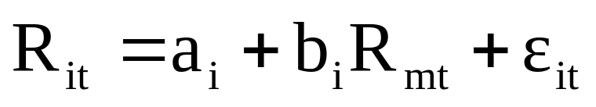
Estimation Issues
With assumption that stock returns can be described by a single market model, the number of correlation inputs required reduces to the number of assets, plus one
Single index market model:
b_{i} = the slope coefficient that relates the returns for security i to the returns for the aggregate stock market
R_{mt} = the return for the aggregate stock market during time period t

Slide 55
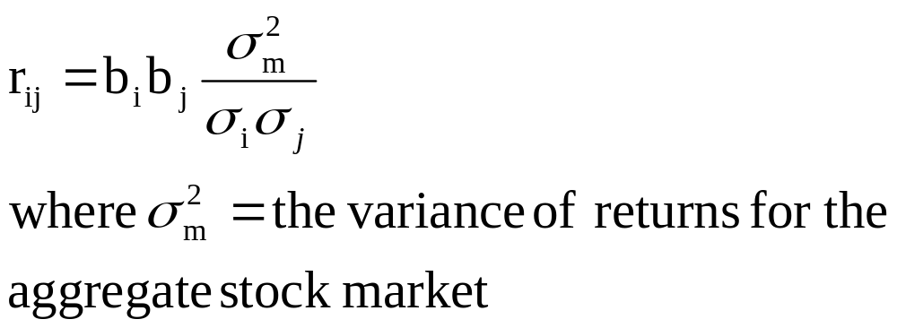
Estimation Issues
If all the securities are similarly related to the market and a b_{i} derived for each one, it can be shown that the correlation coefficient between two securities i and j is given as:

Slide 56
Implementation Issues
If portfolios on the efficient frontier are optimal, why don’t all investors use Markowitz portfolio optimization?
Three key problems complicate implementation:
  Too many inputs required
  Use of estimates can lead to “error maximization”
  Reliance on historical data to obtain estimates

Slide 57
Implementation Issues
Too many inputs required
  Limit use to asset allocation or small-scale problems
  Use factor models to obtain / develop correlation estimates
    Allows for use with much larger scale problems
    E.g., all 1700 stocks that Value Line follows
    Simplest factor model is the “single-index market model”

Slide 58
Implementation Issues
Use of estimates can lead to “error maximization”
  Introduce additional “hard” constraints in optimization process
    E.g., Haugen, p. ??
    Use stratified sampling
    Precludes optimized portfolio from being too different from the benchmark portfolio
  Use “portfolio resampling” to find average optimal portfolio given range of possible estimates

Slide 59
Implementation Issues
Reliance on historical data to obtain estimates
  True parameters not only never known, but also not constant over time
  Factor models and stratified sampling help here, too
    Factor model relationships tend to be more stable than relationships between individual stocks
    Stratified sampling constraints prevent portfolio from falling too far behind benchmark even when estimated relationships change

Slide 60
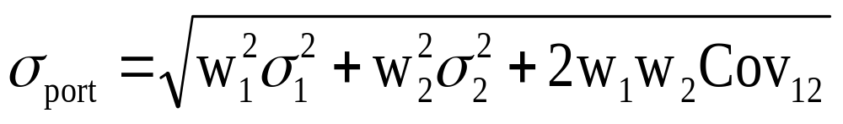
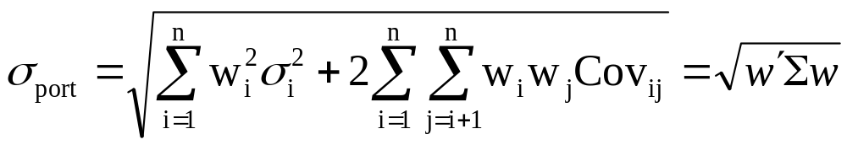
Minimum Variance Portfolio (MVP)
Two-stock case:
Multiple stock case:

Slide 61
The Internet
Investments Online
www.pionlie.com
www.investmentnews.com
www.micropal.com
www.riskview.com
www.altivest.com

Slide 62

Future topics
Chapter 8
Capital Market Theory
Capital Asset Pricing Model
Beta
Expected Return and Risk
Arbitrage Pricing Theory

